Slide 1
TREPONEMA PALLIDUM
DR.R.S.GOPIKA
DEPT of PATHOLOGY SKHMC

Slide 2
"He who knows syphilis, knows medicine"
Sir William Osler

Slide 3
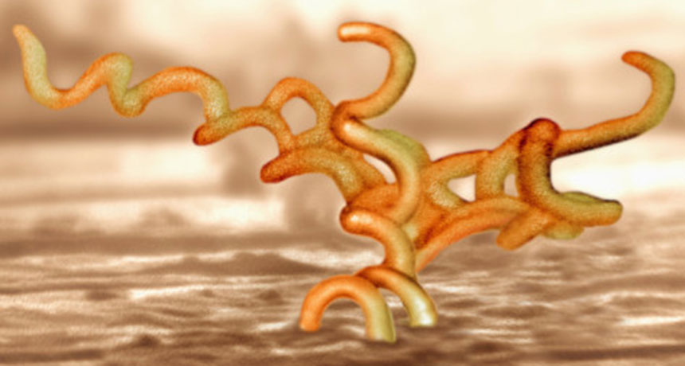
TREPONEMA PALLIDUM

Slide 4
TREPONEMA PALLIDUM
gram negative,Size –10–14 X 0.1–0.2 μm
10 regular spirals at interval of about 1 μm.
does not have lipopolysaccharide (LPS)
long-flagella are inserted into the periplasm(endoflagella)
actively motile, moving with a corkscrew motion, with bending and flexing
generation time - 30–33 hours

Slide 5
RESISTANCE
sensitive to
drying,
chemicals,
heat - as low as 42ºC

Slide 6
Virulence factors
Outer membrane protein – adherence to host cell
surface.
Hyaluronidase – facilitates perivascular invasin
Fibronectin – prevent phagocytosis

Slide 7
CLINICAL SYNDROMES
1. Venereal syphilis
(transmitted by sexual contact) 2. Nonvenereal syphilis
- congenital syphilis
- occupational syphilis

Slide 8
PATHOGENESIS - MoT
Penetration
- Via skin and mucuos membrane through abrasions during sexual contact
Transplacentally
Dissemination
Lymphatic
haematological

Slide 9
Spread:
IP- 9-90 days
T.pallidum rapidly penetrates through minute abrasions on skin or mucosa
within a few hours, enters the lymphatics and blood to produce systemic infection and metastatic foci long before the
appearance of a primary lesion.
Blood is infectious even during the incubation period or in the early stage of syphilis.
•

Slide 10
PATHOLOGY
Proliferative endarteritis
Ischaemia produced by vascular lesions
Immune response
lesions – T-cells, plasma cells and macrophages

Slide 11
STAGES OF SYPHILIS
Primary
Secondary
Latent
Early latent
Late latent
Late or tertiary
Neurosyphilis
Cardiovascular syphilis
Late benign (gumma)

Slide 12
PRIMARY SYPHILIS
painless ulcer is presentation at the site of entry.
Occurs 3 weeks after infection
lesion - Chancre
during this time the spirochetes will get into blood & spread to target organs (Lymph nodes, joints, muscle, skin, liver, etc)

Slide 13
Chancre
Starts as painless, erythematous indurated papule – ulcer
Usually single , painless, clean, well defined.
Nontender & markedly indurated
Lymphadenopathy Inguinal lymph node invariably involved •
Site - genital, perineal or anal area
Heal spontaneously leaving behind tissue paper scar.

Slide 14
PRIMARY SYPHILIS
Regional lymphadenopathy:
classically rubbery, painless, bilateral esp in ingunal lymph node
Histopathologic hallmarks
endarteritis (which in some instances may be obliterative in nature) and a plasma cell–rich infiltrate
Serologic tests for syphilis may not be positive during early primary syphilis

Slide 15
Secondary syphilis
develops 4-8 weeks after the healing of primary lesion. Skin and mucous membranes are commonly affected.
Characteristic lesions:
Skin rashes
Condylomata lata (mucocutaneous papules which coalesce to form large pink to grey lesions in warm moist intertriginous areas (perianal iegion,vulva, and scrotum)
Mucous patches (superficial mucosal erosions)
Generalized lymphadenoparhy

Slide 16
Other manifestations of secondary syphilis - Rashes, -Malaise, fever,weight loss ,Alopecia
Serological tests – highest especially in red lesions in vagina or mouth

Slide 17
Secondary Syphilis -Macular Eruption
Exanthematic erythema –
6-8 weeks after chancre,
extends rapidly,
last for - hours to months
Round indistinct, slightly scaling
ham-colored macules
Pain, pruritus may be present
Generalized lymphadenopathy

Slide 18
Secondary Syphilis- Papular Eruptions
symmetric papular eruption appears
involving entire trunk and the extremities, palm and soles
Papules - reddish brown,scaly,discrete,0.5–2 cm in diameter
Ollendorf’s sign- where there is deep dermal tenderness on pressing

Slide 19
Secondary Syphilis-Mucous membrane
Mucous patches
macerated, flat. Grayish, rounded erosions covered by a delicate, soggy membrane.
Highly infectious,
occur on tonsils, tongue, pharynx, gums, lips, and buccal areas, or on the genitalia

Slide 20
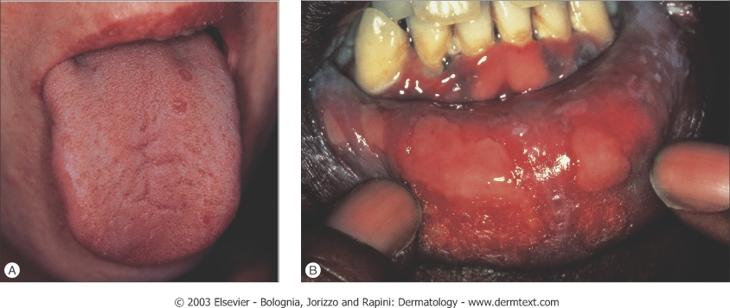
Mucous patches

Slide 21
Histologic examination
proliferative endarteritis,
lymphoplasmacytic inflammatory infiltrate.
Spirochetes are present and easily demonstrable within the mucocutaneous lesions
The mucocutaneous lesions of both primary and secondary syphilis are highly infectious.

Slide 22
Latent period
Following secondary disease, host enters latent period
First 4 years = early latent
Subsequent period = late latent
About 40% of late latent patients progress to late tertiary syphilitic disease

Slide 23
Latent syphilis
is characterized by absence of clinical manifestations of syphilis with positive serological rests for syphilis and normal CSF findings.
it may be
Early latent syphilis (occurs within first year after infection)
Late latent syphilis (occurs after die first year of infection).
Pts are still infectious

Slide 24
Latent syphilis
Latent syphilis may have one of the following fates:
Persistent lifelong infection (common)
Development of late syphilis (rare)
Spontaneous cure

Slide 25
Tertiary
There may be an interval of 1 - 20 yrs from acute infection to clinical onset of tertiary stages of disease
Tertiary syphilis divided into three main groups
Late benign syphilis
Cardiovascular syphilis
Neurosyphilis

Slide 26
BENIGN TERTIARY SYPHILIS
Characterized by Gumma
appear 3-10 yrs after infection
proliferative granulomatous inflammatory process causing destructive of affected tissues
Most lesions occur in skin and bones, with lesser frequency in mucosa and of viscera muscles and ocular structures

Slide 27
Tertiary- Cutaneous Syphilid
Nodular-
reddish brown firm papules or nodules 2mm or larger, scales.
Gumma-
larger

Slide 28
Cutaneous Syphilid
Nodular and noduloulcerative lesions
deep indurated nodule reddish brown in colour that varies in size
Multiple nodules sometimes
Site –
face ,scapular, interscapular areas and extremities
remain for weeks or months and heal without breaking down but - show scarring
If nodular lesions break down to noduloulcerative form, they heal leaving atrophic noncontractile scar

Slide 29
Gumma
solitary lesions
granulomatous inflammation with central necrosis .
found most often in the skin, skeletal system, mouth, upper respiratory tract, liver, and GIT.
Start as nodule, solitary or multiple breaks to form punched out ulcers.

Slide 30
Microscopical features
The gumma contains a central zone of coagulation necrosis surrounded by a mixed inflammatory infiltrate composed of lymphocytes, plasma cells, epithelioid cells, occasional giant cells, and a peripheral zone of dense fibrous tissue.

Slide 31
gumma- different sites
Skeleton-periostitis, gummatous osteitis and sclerosing osteitis.
C/Fs-
pain (especially nocturnal), tenderness, swelling, bony tumor, stiffness and limited motion
Gummatous osteitis of the nasal bones, hard palate and nasal septum
Digestive system-can involve any part
Gumma of the liver -most common
Myocardium-gummas especially of the left ventricle

Slide 32
Cardiovascular Syphilis
Clinically manifest after latent period of 15–30 years
Pathology
have predilection for vasa vasorum of aorta particularly the proximal aorta
Produce transmural inflammatory lesions - endarteritis of these vessels

Slide 33
Cardiovascular syphilis
CVS involvement leads to-
aortitis,
aortic regurgitation,
saccular aneurysm,
and coronary ostial stenosis.

Slide 34
Cardiovascular syphilis
Endarteritis obliterans of the vasa vasorum
scarring of the media of the proximal aortic wall
loss of elasticity
dilation of the aortic root and arch
aortic insufficiency , aneurysms proximal aorta.
narrowing of the coronary arter ostia due to subintimal scarring leads to secondary myocardial ischemia.

Slide 35
Cor Bovinum
Due to Syphilitic aortitis the aortic valve ring becomes dilated aortic valve insufficiency.
As blood regurgitates into the left ventricle between each systole volume overload ventricular wall hypertrophies .
The massive ventricle can lead to a heart weighing over 1000 grams (N-350 grams), known as "Cor Bovinum"

Slide 36
Neurosyphilis
Divided into 5 groups, which may overlap:
Asymptomatic neurosyphilis
Syphilitic meningitis
Meningovascular syphilis
General paresis
Tabes dorsalis

Slide 37
Asymptomatic neurosyphilis
CSF abnormalities,
such as pleocytosis
protein elevation
a reactive VDRL

Slide 38
Early Neurosyphilis
A/c or sub acute meningitis
- present within 1 year of infection.
-headache, nausea, vomiting, neck stiff- ness,
- cranial nerve disorders (SNHL, visual), seizures, delirium, increased ICP

Slide 39
Meningovascular involvement
occurs 5–10 years after infection
endarteritis & inflammation→cerebrovascular thrombosis & infartion
usually presents as a subacute encephalitic prodrome and is followed by a gradually progressive vascular syndrome.

Slide 40
Hemiplegia, aphasia, hemianopsia, transverse myelitis, progressive muscular atrophy
CN palsies- CN IIX, III, IV, VI
“Argyll Robertson Pupil” accommodates, but doesn’t react

Slide 41
Late Neurosyphilis
Parenchymatous neurosyphilis
occurs more than 10 years after infection
Two classical patterns
- Tabes Dorsalis
- General Paresis

Slide 42
General paresis
Occurs 10-20 years after initial infection -changes in
personality,
sensorium (illusions, delusions, hallucinations),
intellect (decrease in recent memory and orientation, judgment, calculations, insight), and speech.
affect reflexes (hyperactive),
eye (Argyll Robertson pupils) -uncommon

Slide 43
Tabes dorsalis or syphilitic myelopathy
takes 25–30 years
demyelination of posterior columns, dorsal roots, and dorsal root ganglia
- ataxia, wide-based gait and footslap; paresthesia; bladder disturbances; impotence;
-loss of position, deep pain, and temperature sensations.
- Trophic joint degeneration (Charcot’s joints),
- optic atrophy and Argyll Robertson pupils.

Slide 44
Congenital Syphilis
transmitted in utero after the first 16 weeks of pregnancy,
therefore it is usually not a cause of abortion during the first trimester.

Slide 45
Manifestations of congenital syphilis
Include
stillbirth,
early infantile syphilis,
and late (tardive) congenital syphilis.

Slide 46
stillbirth
the most common manifestations are
hepatomegaly,
bone abnormalities,
pancreatic fibrosis, and
pneumonitis.
Liver shows extramedullary hematopoiesis and portal tract inflammation.

Slide 47
Stillbirth
Changes in the bones
-inflammation and disruption of the osteochondral junction in long bones
-bone resorption and fibrosis of the flat bones of the skull.
The lungs –
- firm and pale as a result of the presence of inflammatory cells and fibrosis in the alveolar septa (pneumonia alba).
Spirochetes are readily demonstrable in tissue sections

Slide 48
Infantile syphilis
congenital syphilis in live born infants
clinically manifest at birth or within the first few months of life.
Affected infants present with chronic rhinitis (snuffles) and mucocutaneous lesions similar to those seen in secondary syphilis
in adults.
Visceral and skeletal changes resembling those seen in stillborn infants.

Slide 49
Early Congenital Syphilis
Cutaneous manifestations appear most commonly during 3rd week
Snuffles is most frequent, bloody drainage, ulcers may develop, later septal perfs
30-60% of infants develop cutaneous lesions similar to secondary syphilis
Red to copper maculopapular, become large, scaling, pustules, crusting
Face, arms, buttocks, legs, palms and soles

Slide 50
Early Congenital Syphilis
Face, perineum, and intertriginous areas, usually fissured lesions resembling mucous patches.
Radial scarring results in Rhagades
Bone lesions occur in 70-80% -
epiphysitis is common and causes pain on motion, leading to infant refusing to move Parrot’s pseudoparalysis.

Slide 51
Early Congenital Syphilis
the bone lesions in congenital syphilis during the first 6 months are characteristic.
Bone lesions occur at the epiphyseal ends of long bones.
Lymphadenopathy, hepatomegaly,nephrotic syndrome, meningitis, nerve palsies may all occur

Slide 52
Late Congenital Syphilis
Lesions are two types-
malformations of tissue
affected at critical growth periods (Stigmata), and persistent inflammatory foci
Inflammatory-
lesions of the cornea, bones, and central nervous system. Interstitial Keratitis in 20-50%, perisynovitis of knees (Clutton’s joints), tabes dorsalis, seizures, and paresis

Slide 53
Late Congenital Syphilis
Malformations (Stigmata)
destructive effects leave scars or developmental defects
Hutchinson’s Triad
Changes in incisors, corneal scars, and eighth nerve deafness

Slide 54
Hutchinson’s Teeth
Malformation of the central upper incisors that appears in the second or permanent teeth.
Teeth are cylindrical rather than flattened, cutting edge narrower than base, notch may develop
Mulberry molar-
first molar hyperplastic, flat occlusal surface covered with knobs representing abortive cusps

Slide 55
Late Congenital Syphilis
saber shin deformity caused by chronic inflammation of the periosteum of the tibia,
chronic meningitis,
chorioretinitis, and
gummas of the nasal bone and cartilage with a resultant "saddle-nose" deformity.

Slide 56
Placental changes
is enlarged, pale, and edematous.
Microscopy –
proliferative endarteritis involving the fetal vessels, a mononuclear inflammatory reaction (villitis), and villous immaturity.

Slide 57
Lab diagnosis of syphilis Tests
four categories
(i) direct microscopic exam - used when lesions are present
(ii) non treponemal tests - used for screening
(iii) treponemal tests - are confirmatory
(iv) direct antigen detection tests - used in research settings and as gold standards for test evaluation

Slide 58
Direct detection methods
Animal inoculation
Dark-field microscopy
• When lesions are present,
most specific and easiest means of diagnosing syphilis is by direct detection of organism esp during primary, secondary, infectious relapsing and early congenital syphilis

Slide 59
Dark-field microscopy
specimen source - Enlarged regional lymph nodes
After cleansing lesion, gently abrade it and apply gentle pressure until only clear serum exudes
Place a drop of serum on surface of cover slip or slide
specific and immediate diagnosis of syphilis
Sensitivity of this test is not more than 50% hence it should be done on 3 consecutive days

Slide 60
non treponemal tests
Non treponemal (reagin) tests measure IgM and IgG antibodies to lipoidal & lipoprotein-like material released from damaged host cells as well as to cardiolipin released from treponemes
VDRL( veneral disease research laboratory test)
USR (unheated serum reagin)
RPR(rapid plasma reagin)
VDRL only test that can be used for testing CSF (NEUROSYPHILIS)

Slide 61
Old test
Wasserman complement fixation test Kahn’s tube flocculation test

Slide 62
Treponemal Tests
Measure antibody directed against T. pallidum antigens
Microhemagglutination assay (MHA)
Fluorescent treponemal antibody (FTA-ABS)
Treponema pallidum particle agglutination (TP-PA)
Enzyme Immunoassay (EIA)
Multiplex Flow Immunoassay (MFI)

Slide 63
Diagnosis of congenital syphilis
Ig M Anti -treponemal Antibodies

Slide 64
REFER
https://www.youtube.com/watch?v=qT-IjDWOgpM
https://www.youtube.com/watch?v=cFRk6CoupDs

